Slide 1

CS-M151B
Computer Systems Architecture
Blaise Tine
UCLA Computer Science

Slide 2

Attendance

Slide 3
Agenda
FPGAs
Memory Mapped I/O
DMA

Slide 4
Image Edge Detection Accelerator
Sobel filter acceleration on FPGA using HLS
Jupyter notebook
Sober filter
FPGA
Input image
Conv.
HLS
Output image

Slide 5
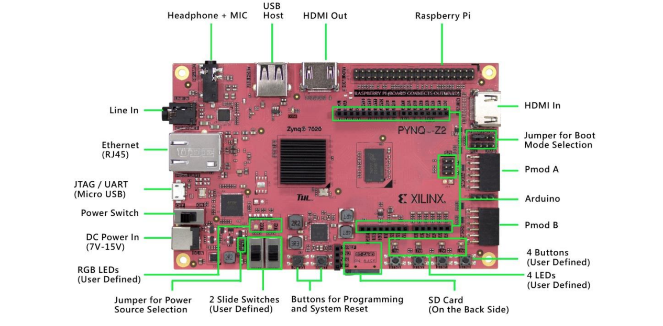
Pynq FPGA Board
Zynq APSoC
https://www.tul.com.tw/images/PYNQ-Z2_PA_v2_pp_20201209_STD.pdf

Slide 6
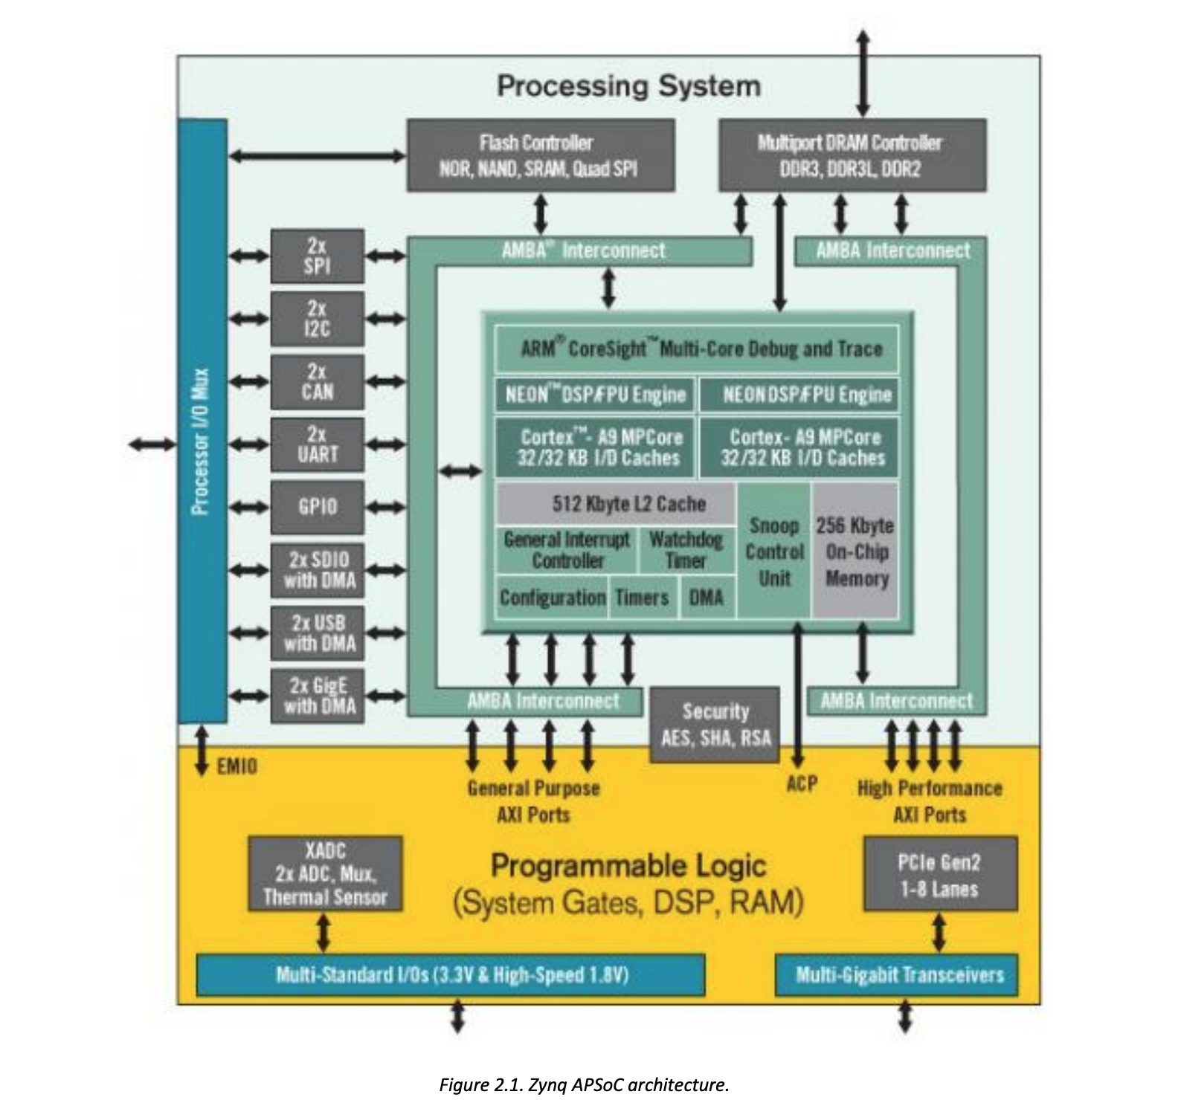
Zynq APSoC Architecture
SoC FPGA architecture
PS: ARM Cortex A9 CPU
PL: Xilinx Zynq FPGA
Connect with AMBA interconnect

Slide 7
FPGA vs. ASIC
http://anysilicon.com/wp-content/uploads/2016/01/FPGA-vs-ASIC.jpg
NRE: Non-recurring engineering costs

Slide 8
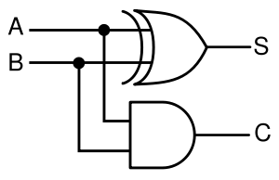
FPGA Architectures
How to implement programmable circuits?
High level view:
Every combination logic is eventually a truth table
Example: half adder
Input |  | Out
A | B | S
0 | 0 | 0
0 | 1 | 1
1 | 0 | 1
1 | 1 | 0
Input |  | Out
A | B | C
0 | 0 | 0
0 | 1 | 0
1 | 0 | 0
1 | 1 | 1

Slide 9
Look-up-tables (LUTs)
Implement truth table (LUTs) in small memories and program the memory values
Usually SRAM
A | B | S
0 | 0 | 0
0 | 1 | 1
1 | 0 | 1
1 | 1 | 0
A | B | C
0 | 0 | 0
0 | 1 | 0
1 | 0 | 0
1 | 1 | 1
2-input, 1-output LUTs
0
1
1
0
00
0
0
0
1
Address: inputs
Addr
Addr
A
01
A
01
B
10
B
10
11
11
Output
Output
S
C

Slide 10
LUTs
Combine two tables: when the outputs are used together
0
1
1
0
00
0
0
0
1
00
0
1
1
0
0
0
0
1
00
Addr
Addr
Addr
01
A
01
A
01
10
B
10
B
10
11
11
11
S
C
S
C

Slide 11
How to build Sequential Logic?
Sequential logic:
Needs to maintain states
Truth table won’t be enough to build sequential logic.
Possible solution
Add a flip-flop to the output of LUT
3-in, 1-out
LUT
3-in, 2-out
LUT
FF
FF
FF

Slide 12
How to build a register?
LUT simply passes inputs to appropriate output
Inputs/Outputs
LUT functionality
Corresponding Truth Table
x(1)
x(0)
x(1)
x(0)
x(1)
x(0)
y(1)
y(0)
3-in, 2-out
LUT
0 0 0
0 | 0
0 | 1
1 | 0
1 | 1
0 | 0
0 | 1
1 | 0
1 | 1
0 0 1
0 1 0
FF
FF
FF
FF
0 1 1
1 0 0
y(1)
y(0)
y(1)
y(0)
1 0 1
1 1 0
1 1 1

Slide 13
Basic Units in the FPGA
Xilinx: Configurable Logic Blocks (CLBs)
Altera: Logic Elements (LE) → Logic Array Blocks (LAB)
First issue: How to make flip-flop optional?
Simples way: Use a mx
3-in, 1-out
LUT
FF
2x1

Slide 14
More than 1 LUTs
3 input LUT
FF
2x1
2-1 MUX
Connecting more than 1 LUTs
Carry in
3 input LUT
FF
2x1
Internal connections between LUTs

Slide 15
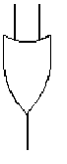
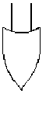
Using Multiple LUTs
a b c d e f g h l j k l m
a b c j k l m
d e f
g h i
x
y
4 input LUT
x
y
5 input LUT
z
z
f₁= (abc + def) (g + h + i) (jk +lm)
This can be implemented by
Four 5 input LUT

Slide 16
Determining the LUT size
LUT and FF
K-bit LUR: 2^k configuration memory bits
As the number of LUT input increases the number of LUT decreases.
Better for performance
Under utilizations
Area trade-off
4 to 6 inputs LUT are mostly common
From: Principles and Structures of FPGAs ( © Springer Nature. 2018)

Slide 17
Island-style FPGA Overview
Arranged as 2-D structure
Hard block: the usage is already fixed
e.g. DSPs
Soft Logic: Programmable units :
Xilinx-configurable logic block (CLB)
Altera: logic array block
Check the Area in a chip for wires vs. logic
From: Principles and Structures of FPGAs ( © Springer Nature. 2018)

Slide 18
Classification of FPGA routing structure
From: Principles and Structures of FPGAs ( © Springer Nature. 2018)

Slide 19
Hierarchical-type FPGA
Altera Flex 10K, Apex, ApexII

Slide 20
DSP Block
FPGA is slow on multiplications, floating point operations
Include custom DSP units instead of mapping onto LUTs
Example units:
Multipliers
MAC (Multiply-Accumulate)
Barrel Shifter
Square root
From: Principles and Structures of FPGAs ( © Springer Nature. 2018)

Slide 21
Memory Using LUTs
LUTs → SRAM
Asynchronous access is possible
Fast but small size (2^6 = ~ 64 bits)
Use too much? Not much space left for LUTs
From: Principles and Structures of FPGAs ( © Springer Nature. 2018)

Slide 22
Memory Blocks in FPGA
Dedicated Memory blocks in FPGA chip
Block RAM (BRAM)
Xilinix-7 series BRAM
Each has 36K-bits
Each BRAM can be either
One 36-K bit memory
Two independent 18-K bit memory
One Two-ports 18-K bit memory
Can’t read the updated data at the same clock as writing
Synchronous write and read (different from distributed RAM)
Ideal for on-chip caches and scratchpads
From: Principles and Structures of FPGAs ( © Springer Nature. 2018)

Slide 23
Fabric with Block RAM
Block RAM can be placed anywhere
BR
CLB
CLB
CLB
CLB
BR
BR
CLB
CLB
CLB
CLB
BR
. . .
BR
CLB
CLB
CLB
CLB
BR
. . . .

Slide 24
Programming FPGAs
How to program/configure FPGAs
We have to initialize SRAM values in LUTS, MUX control signals, switch signals…
Basic idea: Include FF’s in fabric to control programmable components
Use skip mux to route programing bits to desire location
3-in, 1-out
LUT
LE
FPGA can be programmed to use/skip mux by storing appropriate bit
FF
FF
2x1
Select?

Slide 25
FPGAs programmed with a ”bitfile”
Basic idea:
Send a bit stream file and shift in bitfile one bit at a time
CLB
CLB
CLB
CLB
CLB
CLB
CLB
CLB
Shift register shifts bits to appropriate location in FPGA
CLB
CLB
CLB
CLB

Slide 26
Memory Interconnect

Slide 27
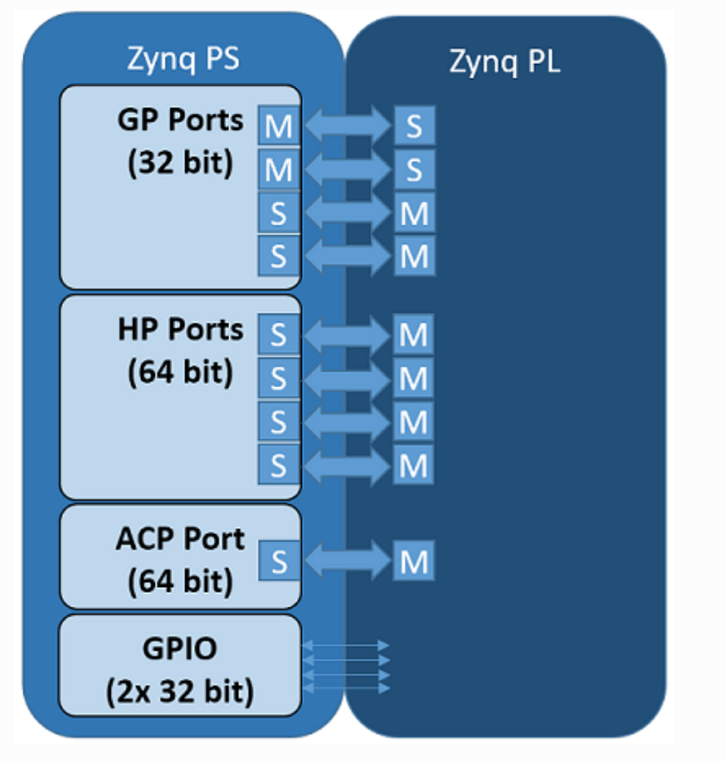
PS/PL Interfaces
How to communicate with PL and PS?
Need to choose a right interface
Zynq uses 4 interfaces
General Purpose Ports (GP)
Memory-mapped transfer (e.g. CSRs)
High-Performance Ports (HP)
High-speed transfer (e.g. DDR memory)
Accelerator Coherency Port (ACP)
Coherency access to PS caches
General Purpose I/O (GPIO)
Best for control signals (start, idle, busy, etc…)
Notes:
ACP Port = Accelerator Coherency port (Allocate mode)

Slide 28
AXI Protocol
Write transaction
Write address channel (←)
write data channel (←)
write response channel (→)
Read Transaction
Read address channel (←)
read response channel (→)
Master initiates the transactions
Slave handles the response
Write transaction data
AXI
Slave
AXI
Master
Read transaction data
© Mohammad Sadri

Slide 29
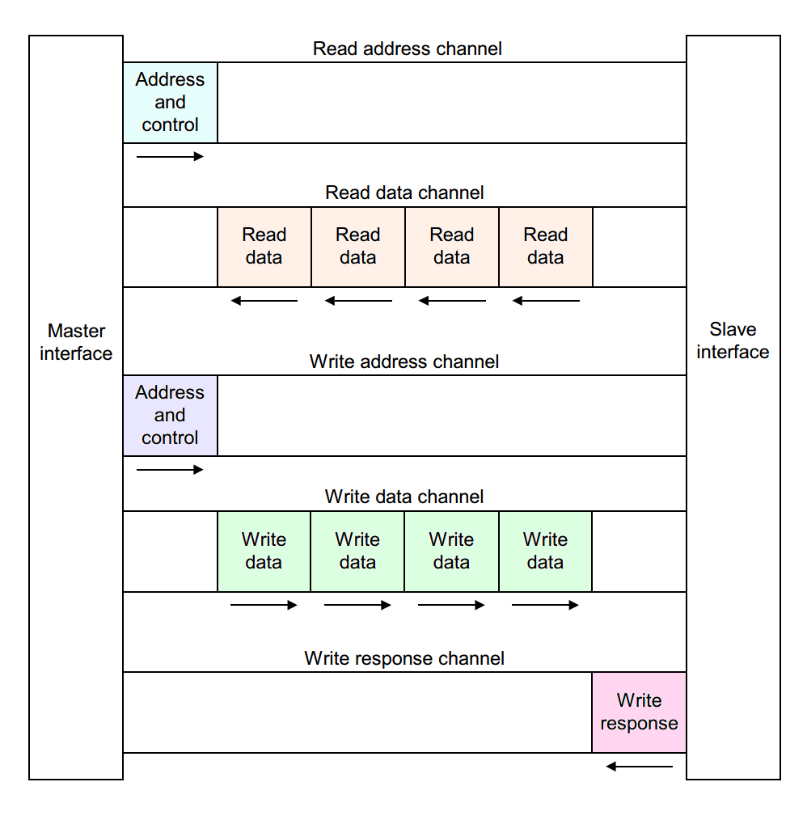
AXI Channels
Master and Slave handshaking with address channel
Every exchange of data is called a transaction (transaction includes the address/data and response)
4 burst mode (4 beats)
https://www.allaboutcircuits.com/technical-articles/introduction-to-the-advanced-extensible-interface-axi/

Slide 30
AXI global signals
Any AXI component has two global signals:
the clock ACLK
an active-low asynchronous reset ARESETN.
AXI4 signals are sampled on the rising edge of the clock and all signal changes must occur after the rising edge.

Slide 31
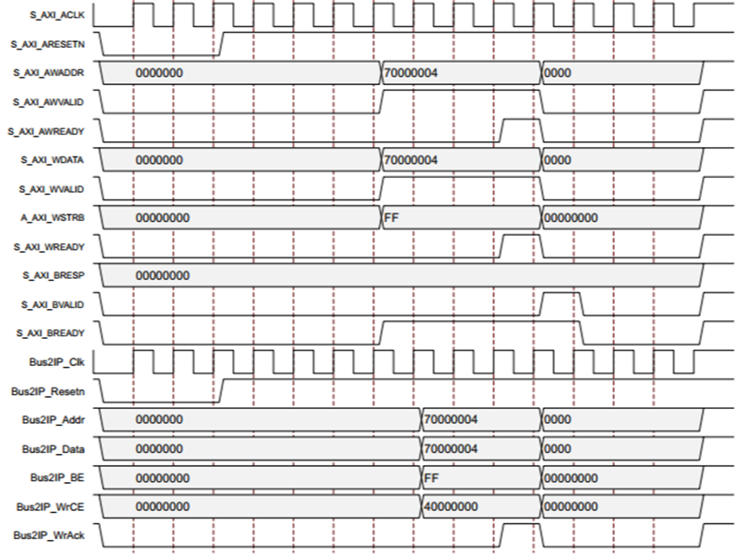
AXI4-Write Transaction
Separate addr & data channels
Master write request
awfire = awvalid & awready
wfire = wvalid & wready
Can both ‘fire’ in same cycle
Slave write response
bfire = bvalid & bready

Slide 32
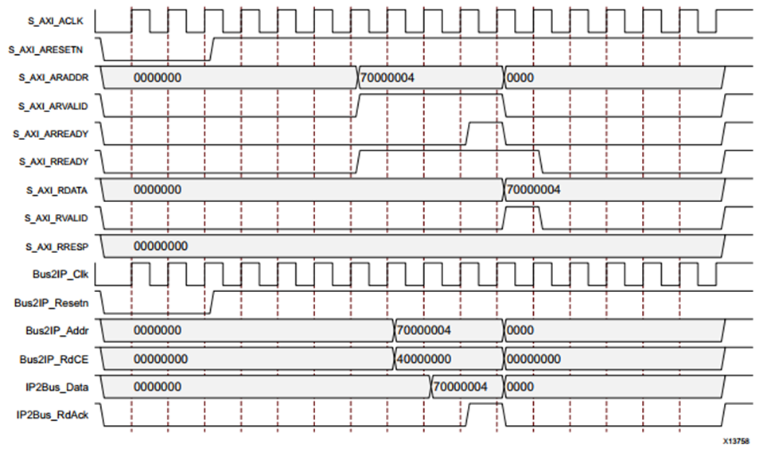
AXI4-Read Transaction
Master read request
arfire = arvalid & arready
Slave read response
rfire = rvalid & rready

Slide 33
AXI4 Protocols
AXI4: A high performance memory mapped data and address interface. Capable of Burst access to memory mapped devices.
AXI4-Lite: A subset of AXI, lacking burst access capability. Has a simpler interface than the full AXI4 interface.
AXI4-Stream: A fast unidirectional protocol for transferring data from master to slave.
https://www.realdigital.org/doc/a9fee931f7a172423e1ba73f66ca4081

Slide 34
AXI4 Stream Protocol
Simple transfer of data in a single transaction (no address!)
A transfer fires when
tvalid & tready == 1
End of packet fires when
tlast == 1
AXI Stream Master
tvalid
AXI Stream Slave
tready
3
2
1
0
tdata
tlast
https://www.realdigital.org/doc/a9fee931f7a172423e1ba73f66ca4081

Slide 35
AXI Interfaces
Full AXI
(Burst Capable)
addr
Data
Data
Data
Data
Memory
Mapped
<Burst>
Resp
AXI-Lite
(Single-beat)
AXI Interfaces
with side channel
tlast
Stream
without side channel
(tkeep, tstrobe)
Data
Data
Data
Data
Data
Data
Tkeep or tstrobe are used to select valid bytes in tranfered block

Slide 36
AXI Interconnect
How to connect multiple AXI components?
Address table
AXI
Slave 1
(UART)
AXI
Master 1
(CPU)
Address Range: 4K
Address offset: 0x400000
Address: 0x400000 – 0x400FFF
AXI
Slave 2
(GPIO)
Address Range: 4K
Address offset: 0x401000
Address: 0x401000 – 0x401FFF
AXI Interconnect
AXI
Master 2
(Master)
Address Range: 4K
Address offset: 0x402000
Address: 0x402000 – 0x402FFF
AXI
Slave 3
(RAM)
© Mohammad Sadri

Slide 37
AXI interconnect
Master and Slave could have different clocks
Master and Slave could have different data #bits
e.g. 64 bits CPU, 32 bits slave.
Hierarchical AXI interconnect is also possible
AXI slave address shouldn’t overlap
© Mohammad Sadri

Slide 38
AXI Data Mover
DRAM
We need to read/write stream of data from a peripherals (e.g. HDMI)
Peripherals use AXI Stream interface with no address
We need to store the data somewhere in memory for CPU to read using a memory mapped AXI interface
HDMI
?
CPU
Allocated Shared Memory
Camera input
?
© Mohammad Sadri

Slide 39
AXI Data Mover
DRAM
HDMI
M_AXIS_MM2S
Transfer Stream data to/from a memory mapped region
CPU
Allocated Shared Memory
CPU configures the AXI data Mover Units
Camera input
S_AXIS_S2MM
© Mohammad Sadri

Slide 40
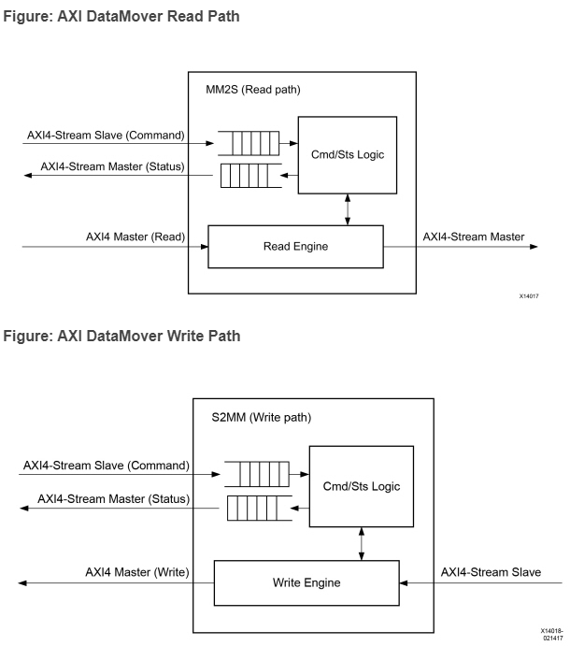
AXI Data Mover
Microarchitecture
Command/status queues
Command/status logic drive the mover engine

Slide 41
DMA

Slide 42
PIO Data transfer
Programmed input-output (PIO)
Peripheral devices: network adapter, GPU, of FPGA etc.
Memory-mapped IO (MMIO)
Address Range
0 – 0x100 | SSD
0x100-0x200 | Network interface
0x200-0x300 | GPU
Processor
System Bus
Memory
Peripheral
Peripheral
Introduction to Direct Memory Access (DMA) by Vipin Kizheppatt

Slide 43
PIO Data Transfer
Only Processor can access memory
The transfer is software control
Peripherals go through the process to access memory
Processor use local registers to store read data before transfer to peripheral
Only one operation at a time (read or write)
Only one device at a time
Even processor cannot perform any other work

Slide 44
IO Programming
Sampling: always valid data, CPU can read whenever it wants
Specific register
Polling: CPU must query device to see whether it is ready
Interrupts: Device notify CPU when ready
DMA: Device is able to control transfer of data to/from memory
IO controllers
Device performs a series of IO operations w/ intervention, requires interrupt when it’s done
IO coprocessors
Device is a separate, fully programmable computer

Slide 45
DMA
Peripheral or Processor can be a master
Processor is not needed. Much faster
Multiple master can exist.
One read/write can be a large chunk
Processor
System Bus
Memory
Peripheral
Peripheral
Introduction to Direct Memory Access (DMA) by Vipin Kizheppatt
45

Slide 46
Bus Arbitration
We can only have one master accessing memory at the time
Arbitration policy (round-robin, prior request etc.)
Req
Arbiter
Processor
Grant
Req
Req
System Bus
Grant
Grant
Memory
Peripheral
Peripheral
Introduction to Direct Memory Access (DMA) by Vipin Kizheppatt
46

Slide 47
DMA controller
How does DMA controller know when to start?
DMA controller is set up by a software (start address, length, direction of communication)
Processor push transfer command into DMA command queue
Status register. (DMA transfer is done, status register set. Processor polls)
DMA is the master to all peripherals but a slave to a processor
Processor
System Bus
Memory
DMA controller
Peripheral
Introduction to Direct Memory Access (DMA) by Vipin Kizheppatt
47

Slide 48
DMA controller – Option #2
Peripheral is directly connected to DMA controller
System Bus can be used for other purpose
Processor
System Bus
Memory
DMA controller
Peripheral
Introduction to Direct Memory Access (DMA) by Vipin Kizheppatt
48

Slide 49
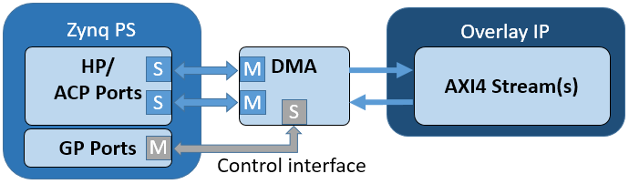
PYNQ Board DMA Architecture
Supports high-performance burst transfer
The control interface uses R/W AXI-lite port
The data interface uses R/W AXI ports from HP or ACP
You PL module uses AXI Stream to access DMA

Slide 50
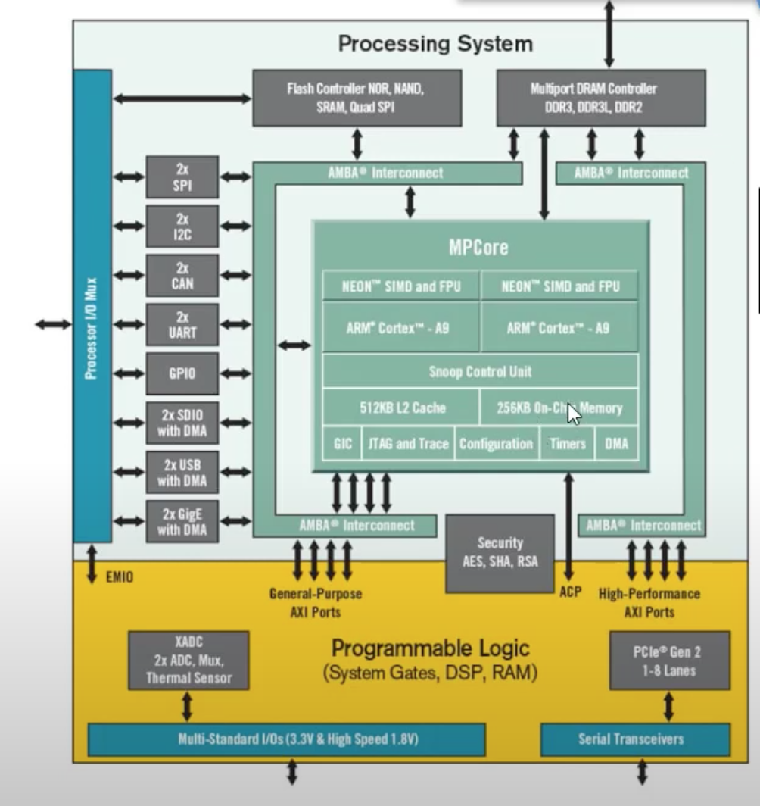


DMA on Zynq
External DDR
How does PL access external Memory ?
AXI GP Port
HP GP Port
Introduction to Direct Memory Access (DMA) by Vipin Kizheppatt

Slide 51
DMA on Zynq
External DDR
DDR controller is multi-port.
Multiple requests can be done
DDR controller (scheduler/interface)
4 General Port AXI Port (master(2), slave(2))
4 High Performance Slave AXI Ports
DMA controller is instantiated in PL DMA is master
Introduction to Direct Memory Access (DMA) by Vipin Kizheppatt

Slide 52
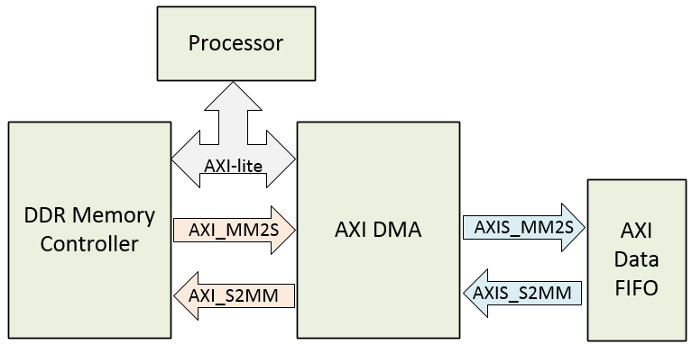
DMA on Zynq
DRAM
Memory
Peripheral

Slide 53
Power Management

Slide 54
Q&A

Slide 55
References
https://www.xilinx.com/html_docs/xilinx2020_1/vitis_doc/programmingvitishls.html#tlb1539734222626
https://www.xilinx.com/html_docs/xilinx2020_1/vitis_doc/programmingvitishls.html#tlb1539734222626
Vitis High-Level Synthesis User Guide : https://www.xilinx.com/support/documentation/sw_manuals/xilinx2021_1/ug1399-vitis-hls.pdf
AXI DMA v 7.1 https://www.xilinx.com/support/documentation/ip_documentation/axi_dma/v7_1/pg021_axi_dma.pdf

Slide 56
Acknowledgement
This course is partly inspired and use materials from the following courses created by my colleagues:
ECE-M1126C: Nader Sehatbakhsh @ UCLA
CS3220: Hyesoon Kim @ gatech

